Slide 1
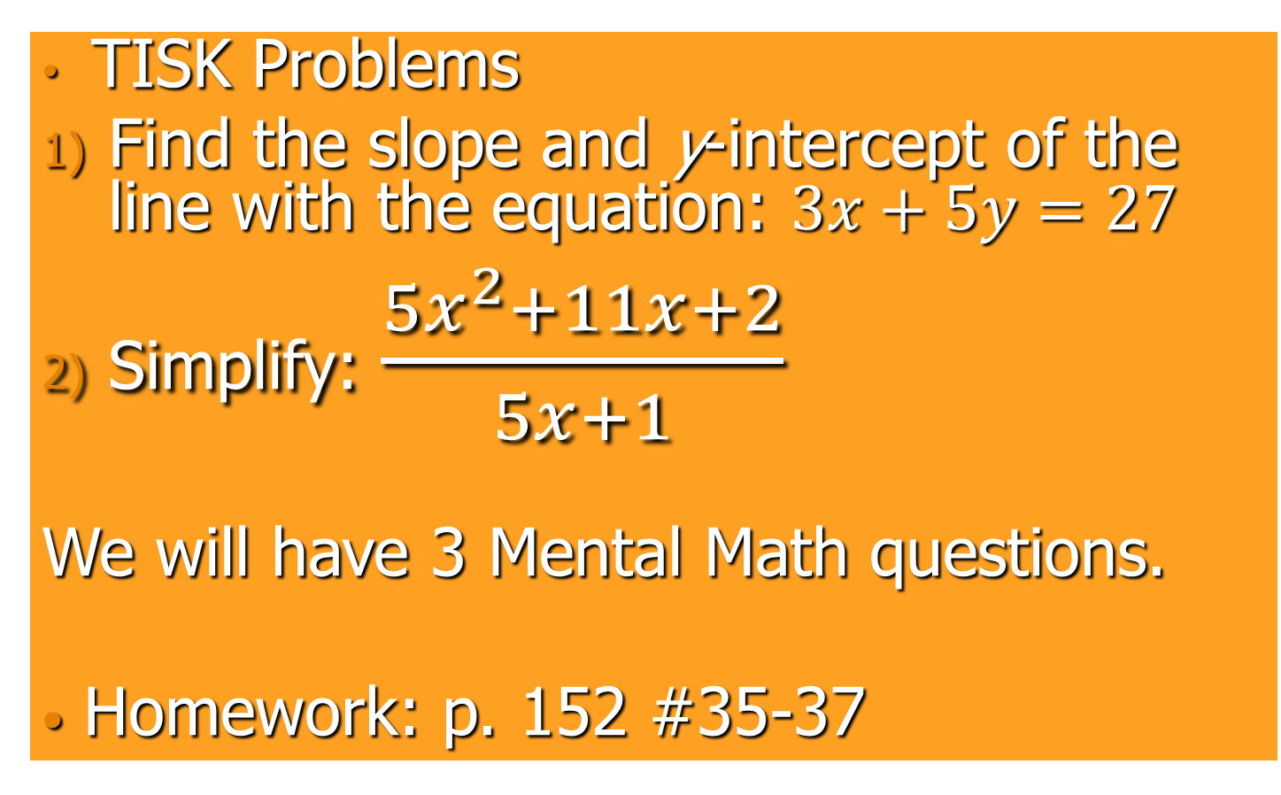
Wednesday, September 12, 2012
TISK Problems
Find the slope and y-intercept of the line with the equation: $3x+5y=27$
Simplify: $\frac{5x^{2}+11x+2}{5x+1}$
We will have 3 Mental Math questions.
Homework: p. 152 #35-37
Notes:
Mental Math
Start with the largest multiple of 3 that is less than 60. Divide by 3. Add 38. Subtract 7. Double it. (100)
Start with the largest multiple of 4 that is less than 80. Divide by 4. Add 48. Subtract 7. Double it. (120)
Start with the largest multiple of 6 that is less than 120. Divide by 6. Add 68. Subtract 7. Double it. (160)

Slide 2

§3.4 Proving Lines are Parallel
Corresponding Angles Converse (Postulate)
  If two lines are cut by a transversal so that corresponding angles are congruent, then the lines are parallel.
  If corresponding $∡$s are $≅⟹$ lines are $∥$ .

Slide 3
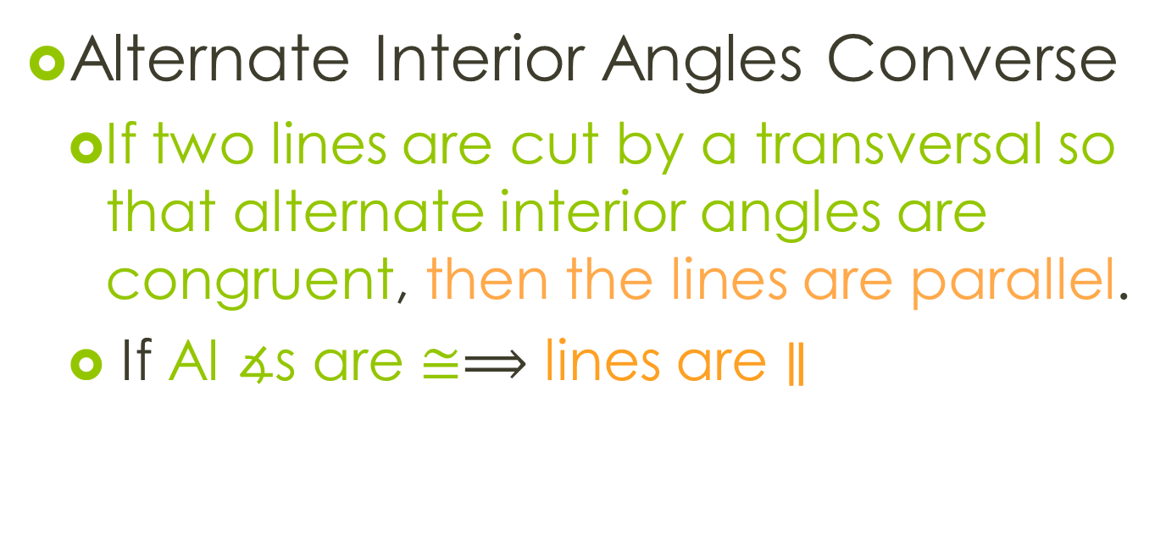
Theorems
Alternate Interior Angles Converse
  If two lines are cut by a transversal so that alternate interior angles are congruent, then the lines are parallel.
  If AI $∡$s are $≅⟹$ lines are $∥$

Slide 4









Proof of AI Angles Converse.
n
3
Given: $∡1≅∡2$
Prove: $m||n$
m
1
2
Statements | Reasons
1) $∡1≅∡2$
1) Given
2) $∡1\&∡3$ are vert. $∡$s
2) Assumed
3) $∡1≅∡3$
3) If 2$∡$s are vert. $∡s⇒they^{′}re≅$
4) $∡2≅∡3$
4) If $∡A≅∡B$ and $∡B≅∡C⇒∡A≅∡C$
5) $m||n$
5) If Corresponding $∡s are≅ ⇒lines are ||$

Slide 5

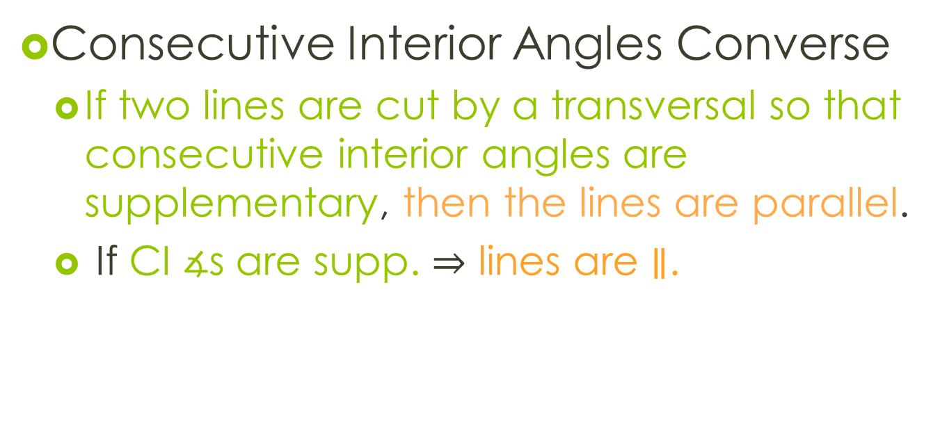
Theorems
Consecutive Interior Angles Converse
  If two lines are cut by a transversal so that consecutive interior angles are supplementary, then the lines are parallel.
  If CI $∡$s are supp. $⇒$ lines are $∥$.
1
2
$∡1\&∡2$ are supp.

Slide 6
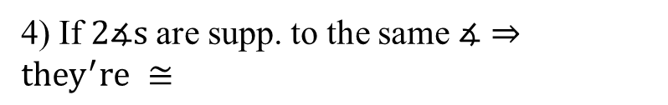


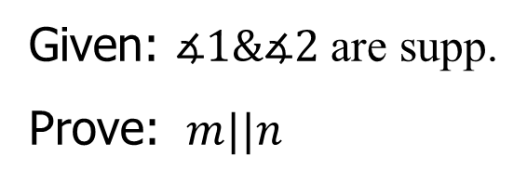





Proof of CI Angles Converse
Given: $∡1\&∡2$ are supp.
Prove: $m||n$
n
3
1
m
2
Statements | Reasons
1) $∡1\&∡2$ are supp.
1) Given
2) $∡1\&∡3$ are a linear pair
2) Assumed
3) $∡1\&∡3$ are supp.
3) If 2$∡$s are a l.p.$⇒$ they’re supp.
4) $∡2≅∡3$
4) If $2∡s$ are supp. to the same $∡⇒they^{′}re ≅$
5) $m||n$
5) If $AI∡s$ are $≅ ⇒$lines are ||

Slide 7
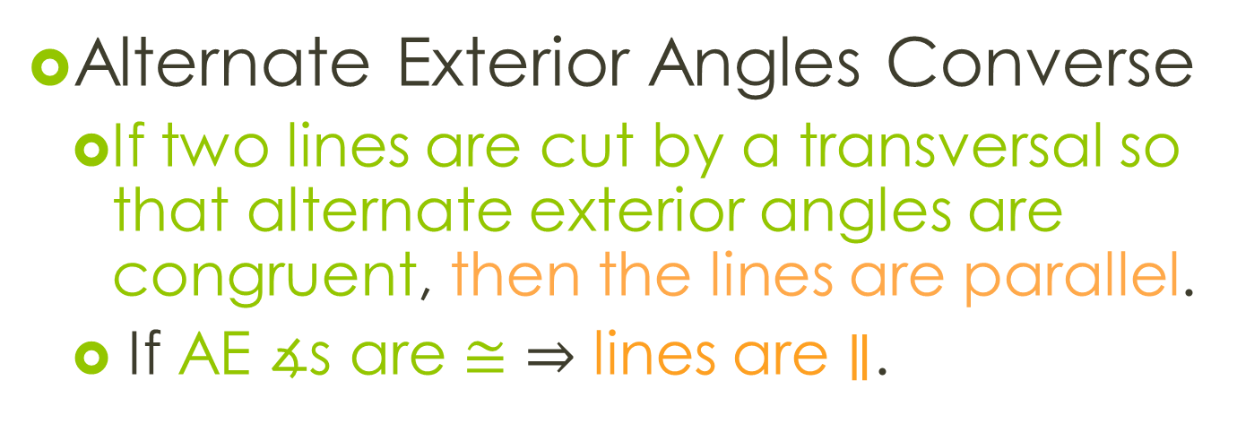
Theorems
Alternate Exterior Angles Converse
  If two lines are cut by a transversal so that alternate exterior angles are congruent, then the lines are parallel.
  If AE $∡$s are $≅$ $⇒$ lines are $∥$.

Slide 8
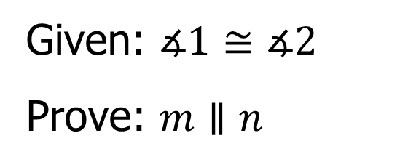
Proof of AE Converse
You will be asked to prove this theorem on a test or a quiz.
n
1
Given: $∡1≅∡2$
Prove: $m∥n$
m
3
2

Slide 9



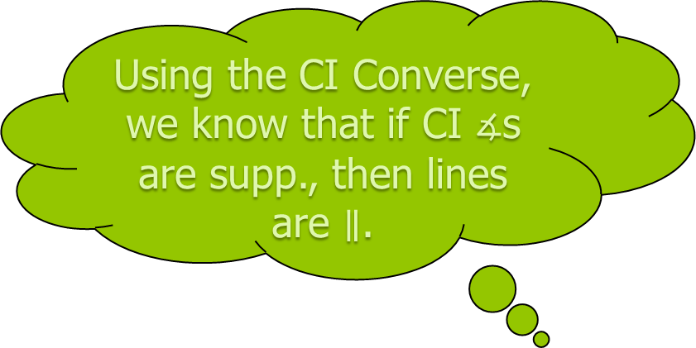



Find the value of x that makes j $∥$ k.
Example.
$$x°$$
$$4x°$$
Using the CI Converse, we know that if CI $∡$s are supp., then lines are $∥$.
k
j
$$x°+4x°=180°$$
$$5x°=180°$$
$$x=36$$

Slide 10

Try this proof using the white boards and working with your seat partner.
Proof Practice
Given: $∡1$ and $∡4$ are supp. & $∡1$ and $∡5$ are supp.
Prove: $j∥k$
Statement | Reason
c
d
1
j
4
5
k

Slide 11
Homework
p. 152 #35-37
  For all proofs, start with a flow proof then write a 2-column proof.

